Slide 1
Going From 0 to 100 with Progressive Web Apps & Ember.js
Greg Hurlman
Software Engineer II, Dynamics 365

Slide 2
Progressive Web Apps 101
Discoverable
Identifyable as apps, findable by search engines
Installable
Available on home screens, without an app store
Linkable
Easily Sharable with URLs
Network Independent
Works offline and/or on low-quality networks
Progressive
Works for all users, all browsers
Re-engagable
Draws user attention back to the app
Responsive
Fits any form factor
Safe
HTTPS always on

Slide 3
Our PWA Checklist
Registers a Service Worker
Responds with a 200 when offline
Contains some content when JavaScript is not available
Uses HTTPS
Redirects HTTP traffic to HTTPS
Page load is fast enough on 3G (< 10s to user interactivity)
User can be prompted to Install the Web App
Configured for a custom splash screen
Address bar matches brand colors
Has a <meta name="viewport"> tag with width or initial-scale
Content is sized correctly for the viewport

Slide 4


Why Ember?
Opinionated
Testable
Simple
Documentation
https://guides.emberjs.com/
Community
https://emberjs.com/community/
Ecosystem
https://emberobserver.com

Slide 5
$ ember new…

Slide 6
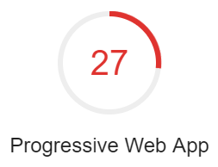
Our PWA Checklist
Registers a Service Worker
Responds with a 200 when offline
Contains some content when JavaScript is not available
Uses HTTPS
Redirects HTTP traffic to HTTPS
Page load is fast enough on 3G (< 10s to user interactivity)
User can be prompted to Install the Web App
Configured for a custom splash screen
Address bar matches brand colors
Has a <meta name="viewport"> tag with width or initial-scale
Content is sized correctly for the viewport

Slide 7
Enter the addons
ember install ember-service-worker ember-service-worker-asset-cache ember-service-worker-cache-fallback
ember-service-worker: Provides baseline support for service workers; provides a pluggable API for you to implement logic for service workers (or use logic others wrote and published as addons)
ember-service-worker-asset-cache: Caches CSS, image and JavaScript assets for the app
ember-service-worker-cache-fallback: Provides offline support for a given path

Slide 8
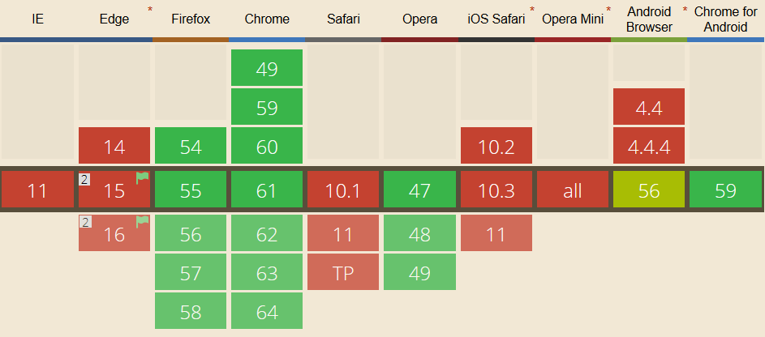
Can I use… service worker

Slide 9
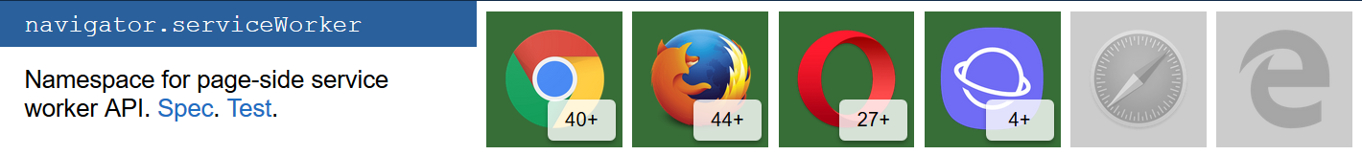
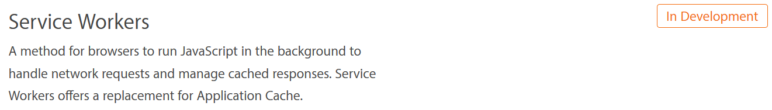
Is Service Worker ready?
https://jakearchibald.github.io/isserviceworkerready/
https://webkit.org/status/#specification-service-workers

Slide 10
$ ember install…

Slide 11
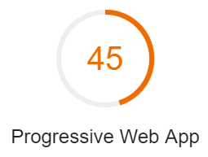
Our PWA Checklist
Registers a Service Worker
Responds with a 200 when offline
Contains some content when JavaScript is not available
Uses HTTPS
Redirects HTTP traffic to HTTPS
Page load is fast enough on 3G (< 10s to user interactivity)
User can be prompted to Install the Web App
Configured for a custom splash screen
Address bar matches brand colors
Has a <meta name="viewport"> tag with width or initial-scale
Content is sized correctly for the viewport

Slide 12
Ember Fastboot
ember install ember-cli-fastboot
Ember FastBoot brings server-side rendering to Ember.js applications. It works by creating a Node.js process and executing your Ember application within it.

Slide 13
$ ember install…

Slide 14
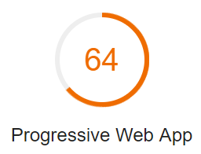
Our PWA Checklist
Registers a Service Worker
Responds with a 200 when offline
Contains some content when JavaScript is not available
Uses HTTPS
Redirects HTTP traffic to HTTPS
Page load is fast enough on 3G (< 10s to user interactivity)
User can be prompted to Install the Web App
Configured for a custom splash screen
Address bar matches brand colors
Has a <meta name="viewport"> tag with width or initial-scale
Content is sized correctly for the viewport

Slide 15
Adding a manifest
ember install ember-web-app
The web app manifest provides information about an application (such as name, author, icon, and description) in a JSON text file.

Slide 16
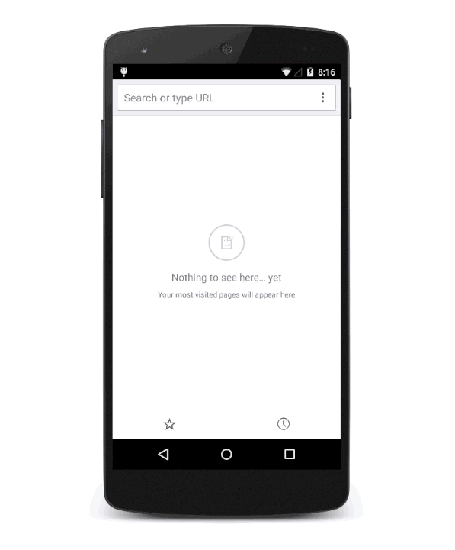

Slide 17
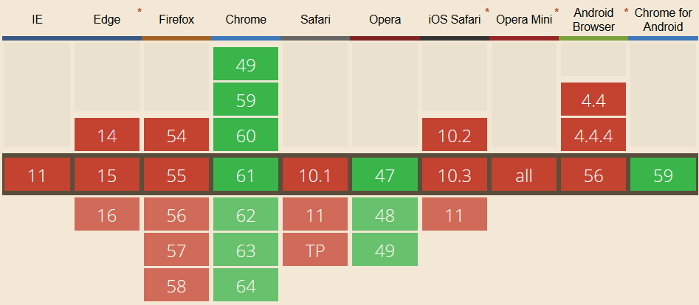
Can I use… manifest

Slide 18
$ ember install…

Slide 19
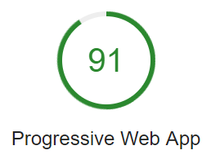
Our PWA Checklist
Registers a Service Worker
Responds with a 200 when offline
Contains some content when JavaScript is not available
Uses HTTPS
Redirects HTTP traffic to HTTPS
Page load is fast enough on 3G (< 10s to user interactivity)
User can be prompted to Install the Web App
Configured for a custom splash screen
Address bar matches brand colors
Has a <meta name="viewport"> tag with width or initial-scale
Content is sized correctly for the viewport

Slide 20
Setting up the server & redirect
npm install --save fastboot-app-server
The FastBoot App Server is an application server for hosting Ember FastBoot apps. It manages downloading the Ember app, starting multiple HTTP server processes, and detecting when new versions of the application have been deployed.

Slide 21
Deployment: Heroku
heroku create
heroku buildpacks:set
https://codon-buildpacks.s3.amazonaws.com/buildpacks/heroku/emberjs.tgz
git push heroku master
heroku open
Uses heroku-cli, Heroku’s command-line tool, and also ember-cli-deploy, a pluggable deployment pipeline

Slide 22
$ npm install && heroku…

Slide 23
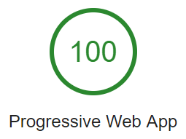
Our PWA Checklist
Registers a Service Worker
Responds with a 200 when offline
Contains some content when JavaScript is not available
Uses HTTPS
Redirects HTTP traffic to HTTPS
Page load is fast enough on 3G (< 10s to user interactivity)
User can be prompted to Install the Web App
Configured for a custom splash screen
Address bar matches brand colors
Has a <meta name="viewport"> tag with width or initial-scale
Content is sized correctly for the viewport

Slide 24


Slide 25

Going From 0 to 100 w/ Progressive Web Apps & Ember.js
Greg Hurlman
twitter: @justcallme98

